Slide 1

Reducing Costs - The Path of Optimization for Chain of Thought Reasoning via Sparse Attention Mechanism
Libo Wang
free.euqality.anyone@gmail.com
Nicolaus Copernicus University
UCSI University

Slide 2
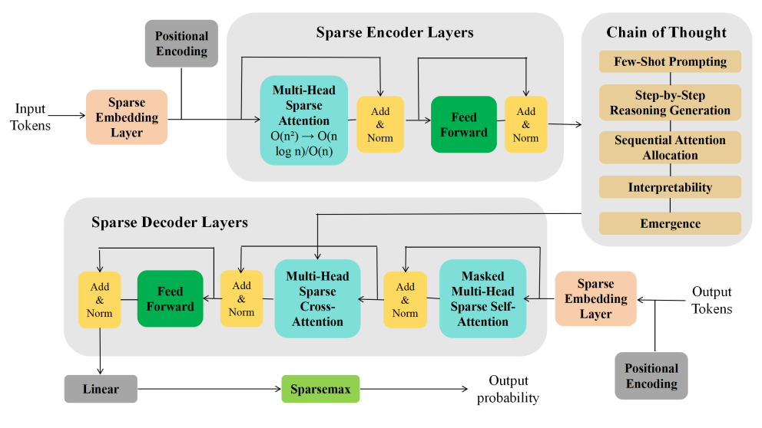
Abstract
Figure 1 - An Innovative Transformer Architecture that Integrates Sparse Attention Mechanisms with Chain of Thought

Slide 3
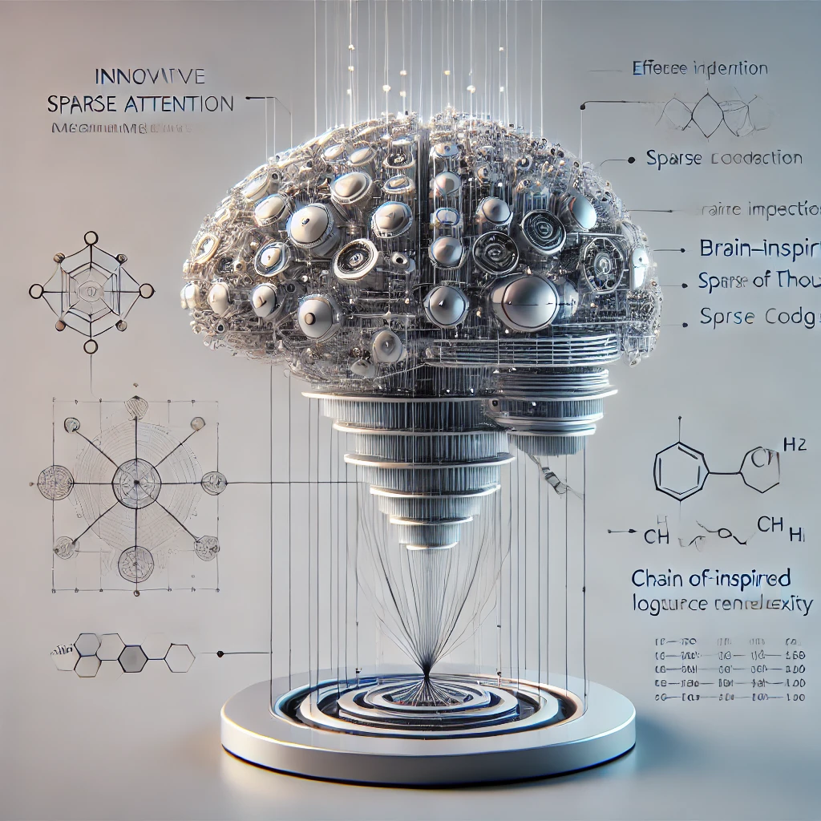
In order to address the chain of thought in the large language model inference cost surge, this research proposes to use a sparse attention mechanism that only focuses on a few relevant tokens.
This research constructed a new attention mechanism and used GiantRabbit trained with custom GPTs as an experimental tool.
The experiment tested and compared the reasoning time, correctness score and chain of thought length of this model and o1 Preview in solving the linear algebra test questions of MIT OpenCourseWare.
The results show that GiantRabbit's reasoning time and chain of thought length are significantly lower than o1 Preview. It verifies the feasibility of sparse attention mechanism for optimizing chain of thought reasoning.
Detailed architectural details and experimental process have been uploaded to Github, the link is:https://github.com/brucewang123456789/GeniusTrail.git.

Slide 4
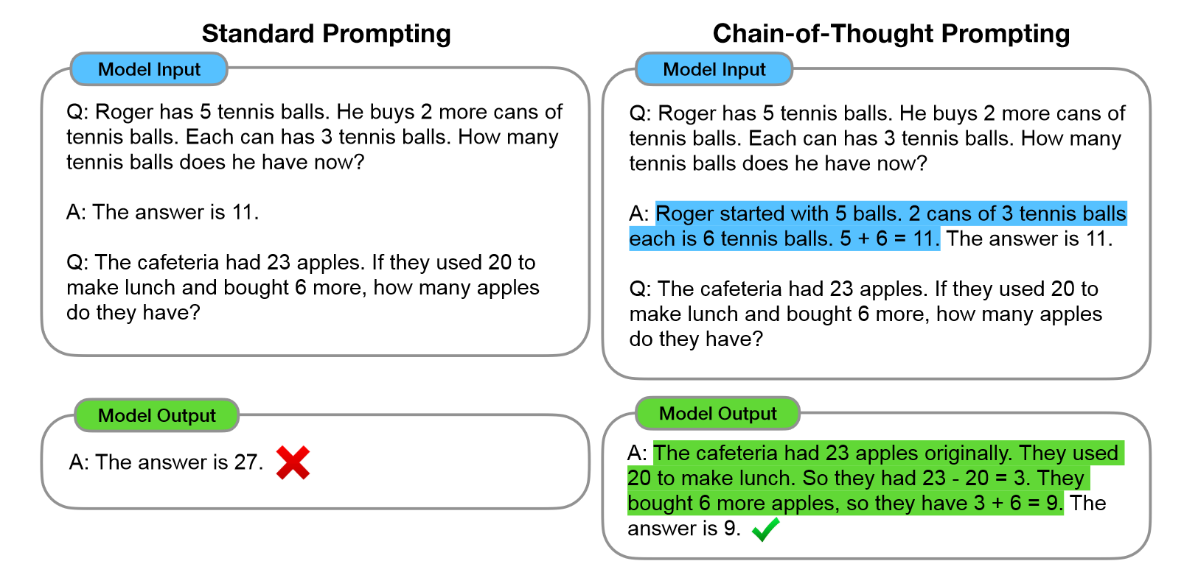
Background
The key to addressing the surge in reasoning cost caused by CoT lies in the computational complexity of the prune self-attention mechanism when dealing with long sequences (Jin et al., 2024).
Since each token needs to be computationally related to all other tokens in the sequence, O(n²) is used for computational complexity (Condevaux & Harispe, 2023).
This means that when the sequence length increases, the computation will grow at the rate of quadrature. It will grow at the rate of quadratic of n, which generates more tokens (Xiong et al., 2021; Zheng et al., 2024).
Figure 2 - Chain of thought prompting enables large language models to tackle complex arithmetic, commonsense, and symbolic reasoning tasks. Chain-of-thought reasoning processes are highlighted (Adapted from Wei et al., 2022).

Slide 5
Sparse Attention Mechanism
Biological Inspiration: Emulates sparse coding in the human visual cortex for efficient data extraction (Zheng et al., 2023).
Efficiency: Reduces attention complexity by focusing on highly relevant lexemes (Frantar & Alistarh, 2023).
Graph Theory Basis: Leverages graph theory to optimize information transfer and computational efficiency (Li et al., 2023).
Sparse Transformer Architecture
Sparse Embedding: Transforms tokens into sparse vectors to reduce dimensionality.
Stabilization: Add & norm layer ensures gradient stability during training (Vaswani, 2017).
CoT Module: Breaks complex reasoning into smaller logical steps (Khot et al., 2022).
Sparse Self-Attention: Focuses on prior outputs to enhance reasoning efficiency.
Sparse Cross Attention: Targets relevant coding-layer outputs with optimized weights.
Sparsemax Activation: Allocates zero weights to irrelevant tokens for precise outputs (Martins & Astudillo, 2016).
Final Output: Linear transformation preserves sparsity features in results.

Slide 6
Proposed Algorithms
Sparse Embedding
Embed (x) = E[x]∈ℝ^{B×N×D}
Sparsity Mask Design and Embedding Optimization
Mathematical Implementation of Sparsity in Embedding
SparseEmbed(x) = Embed(x) ⊙M
Sparse Attention Mechanism
Reducing the computational complexity from O(n)² to O(n) or n*log(n) (Kitaev et al., 2020; Treviso et al., 2021).

Slide 7
Dynamic Sparsity in Reasoning Steps
Sparse Reasoning State Masking
Sparse Cross-Attention Weights
Sparse Self-Attention Weights
Final Decoding Output

Slide 8
Experiment
Model Setup: Two models, "GiantRabbit" and "o1 Preview," were configured for comparative analysis.
GiantRabbit: Based on the proposed sparse attention mechanism, incorporating a customized encoder-decoder transformer architecture with sparse embedding and sparse attention layers.
o1 Preview: An OpenAI model known for its efficiency and accuracy in CoT reasoning but without sparse attention optimizations.
Dataset Selection
The experiment utilized nine linear algebra questions from the MATH 113 Linear Algebra (Exam 1) via MIT OpenCourseWare.
Evaluation Metrics
Reasoning Time: Measured the total time taken by each model to solve a question.
Correctness Score: Evaluated the accuracy of the answers provided by the models.
CoT Length: Assessed the number of reasoning steps required by each model.

Slide 9
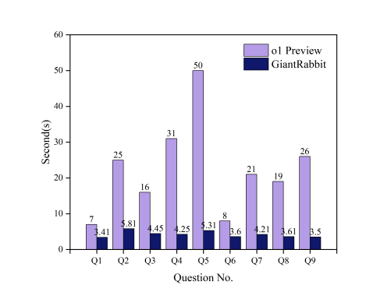
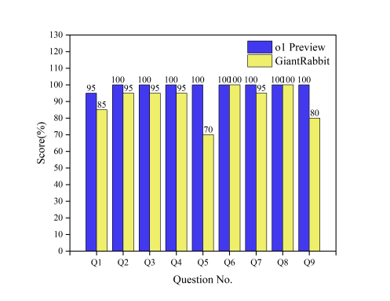
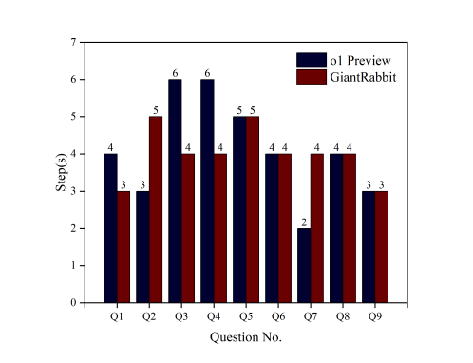
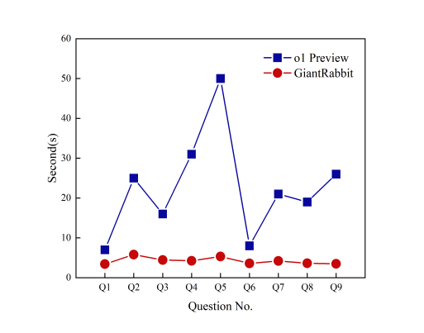
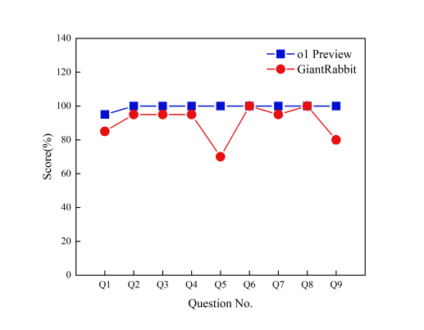
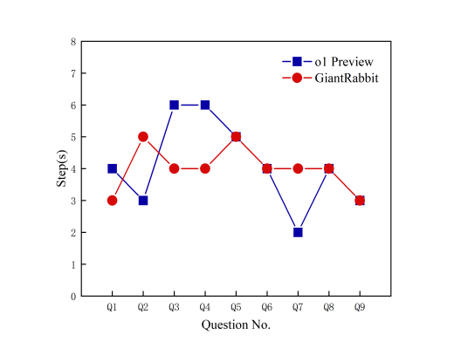
Result
According to the results in Figure 3, o1 Preview and GiantRabbit show significant differences on nine questions.
Figure 4 further shows the fluctuations and performance differences between o1 Preview and GiantRabbit during the problem solving process

Slide 10
Limitations
Currently, OpenAI updates the knowledge base until December 2023, GiantRabbit is trained on GPT-4Turbo. This causes certain interference to the experimental results because it is different from the o1 Preview configuration.
Owing to using commercial language models may cause reasoning time to be affected by API latency and network traffic.
Conclusions
This research's encoder-decoder transformer architecture based on the sparse attention mechanism shows excellent performance in chain of thought reasoning. The researcher compared the performance of GiantRabbit and o1 Preview on the MIT OpenCourseWare linear algebra test questions. The results showed that GiantRabbit has a significant advantage in inference time and number of inference steps, although there is a slight trade-off in accuracy. Experimental results prove that the sparse attention mechanism effectively reduces the cost of chain of thought reasoning, providing experience for training LLMs combined with sparse attention in the future.

Slide 11
THANK YOU

